Slide 1

SHIELD INSURANCE ANALYSIS
Data-Driven Insights for Business Decision Making
Virtual Internship Project
Tools Used: Power BI | Excel | SQL

Slide 2

ABOUT SHIELD INSURANCE
Comprehensive Policies
Wide range of insurance products tailored to diverse needs.
Diverse Clientele
Serving customers across all age groups, ensuring broad market reach.
Multi-Channel Access
Protection accessible via multiple sales channels for convenience.
Data-Driven Focus
Committed to customer-centric decisions backed by robust data analytics.

Slide 3

THE CHALLENGE : EMBRACING DATA
Strengthening Data-Driven Decision-Making
1
Bridging Insight Gaps
Addressing the lack of centralized business insights.
2
Pilot Project Initiative
Testing dashboard effectiveness to validate analytics potential.
3
Influencing Future Partnerships
Successful outcomes will shape long-term collaboration strategies.

Slide 4
PROBLEM STATEMENT
Need to strengthen data-driven decision-making
Lack of centralized business insights
Pilot project to test dashboard effectiveness
Outcome will influence long-term partnership

Slide 5
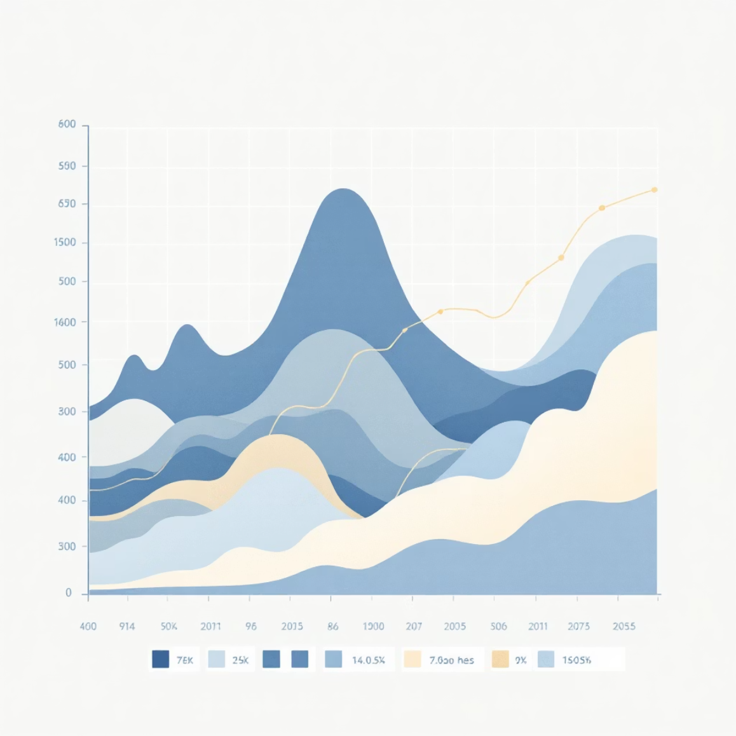

DIVERSE REACH: CHANNELS & DEMOGRAPHICS
Sales Channels Utilised
Customer Age Groups
Offline Agent: Personalised service
18–24: Young adults
Offline Direct: Direct engagement
25–30: Emerging professionals
Online App: Mobile convenience
31–40: Established careers
Online Website: Digital accessibility
41–50: Mid-career stability
51–65: Pre-retirement focus
65+: Retirement and beyond

Slide 6
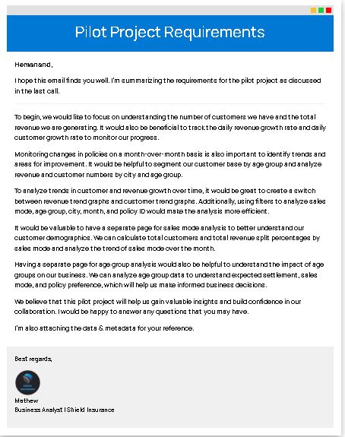
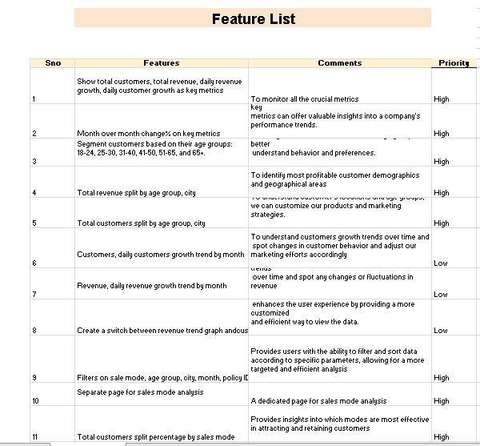
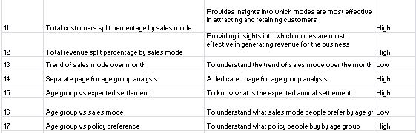

Slide 7
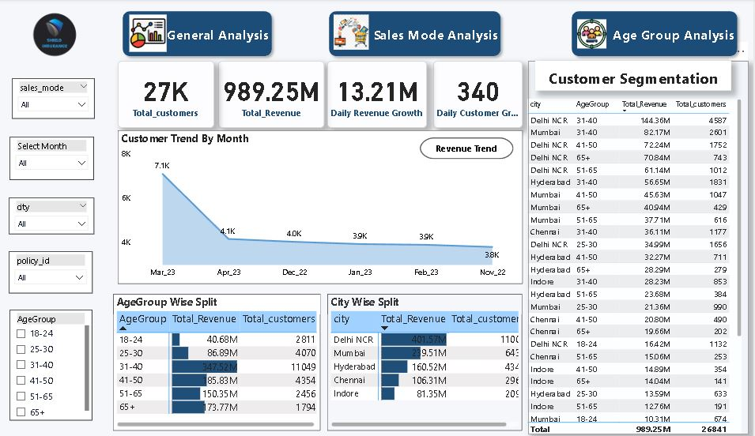
General Analysis

Slide 8
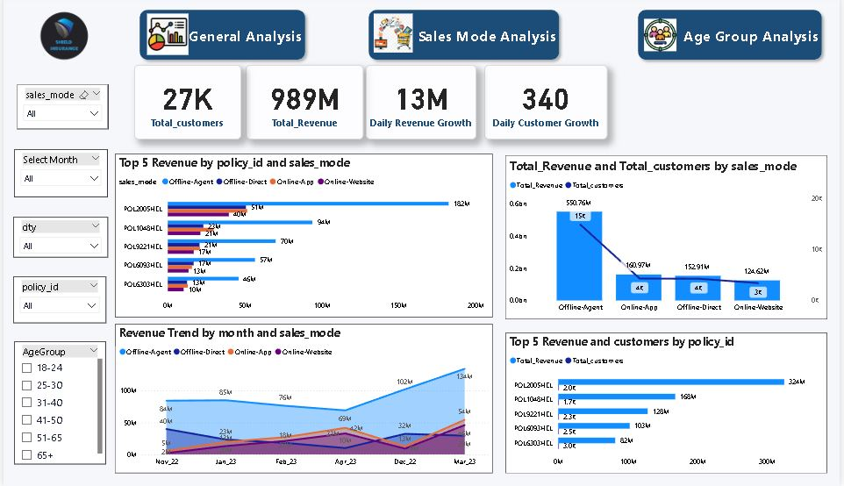
Sales Mode Analysis

Slide 9
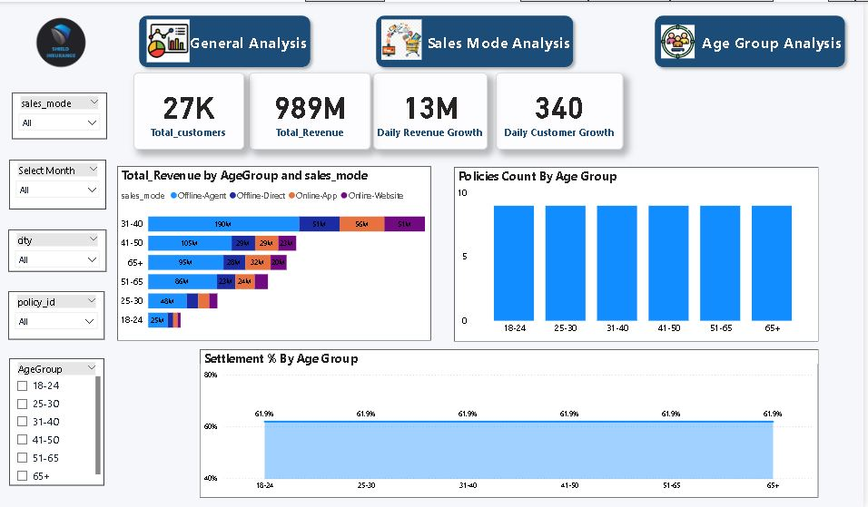
Age Group Analysis

Slide 10

KEY BUSINESS INSIGHTS FROM THE DASHBOARD
1
2
March: Peak Revenue
Delhi NCR: Top Performer
Highest monthly revenue recorded.
Leading city in revenue generation.
3
4
Age Group 31–40: Highest Contribution
Offline Agents: Revenue Drivers
Significant revenue from this demographic.
Dominant channel for revenue generation.
5
6
POL2005HEL: Top Policy
Younger Groups: Lower Settlement %
Highest-performing insurance product.
Opportunity to review and improve claims process.

Slide 11





ACTIONABLE RECOMMENDATIONS
Empower Offline Agents
Invest in training and resources for our top revenue drivers.
Target 31–40 Segment
Develop premium policies catering to their needs.
Boost Online Conversion
Optimise digital channels for enhanced customer experience.
Focus on High-Revenue Cities
Concentrate marketing efforts for maximum impact.
Monitor Young Age Groups
Carefully analyse settlement patterns to improve offerings.

Slide 12
Business Recommendations
Strategic Recommendations for Shield Insurance
1. Focus on sustaining and maximizing revenue during peak months (e.g., March) while identifying causes of lower performance in months like November for targeted improvement.
2. Strengthen business and marketing initiatives in high-performing cities such as Delhi NCR, and design focused growth programs for underperforming cities like Indore.
3. Customize customer engagement and product offerings for the 31–40 age group, while expanding reach among other age segments to diversify revenue sources.
4.Leverage the strong performance of offline agents by enhancing their tools, training, and support, while improving other sales channels for balanced growth
5.Conduct a deeper analysis of high-revenue policies with lower customer counts (e.g., POL2005HEL) to unlock customer acquisition opportunities.
6.Review low-performing policies (e.g., POL4321HEL, POL4331HEL) for redesign, repositioning, or targeted marketing strategies.

Slide 13

CONCLUSION : DASHBOARD'S IMPACT
Accelerated Decisions
Interactive dashboard empowers faster, informed choices.
Enhanced Visibility
Clear insights into revenue streams and customer behaviour.
Pilot Project Success
Dashboard proves its immense value and potential.
Foundation for Growth
Strong base for long-term strategic deployment.

